Slide 1


Vehicle Routing System
COS30018 Intelligent Systems
Group Member
Chloe Soo Ruo Chee (102781705)
Erick Yeo Khai Shing (102772589)
Lai Jun Le (102766401)
Shane Ong (102770282)

Slide 2


Content
Introduction
System Architecture
Communication Protocol
Optimization Technique
Conclusion

Slide 3
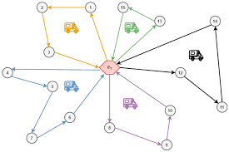
Introduction
Vehicle Routing System
Aims to solve routing problems between delivery vehicles
Multi-agent system
Utilizes two search optimization techniques
Ant colony optimization
Genetic algorithm

Slide 4
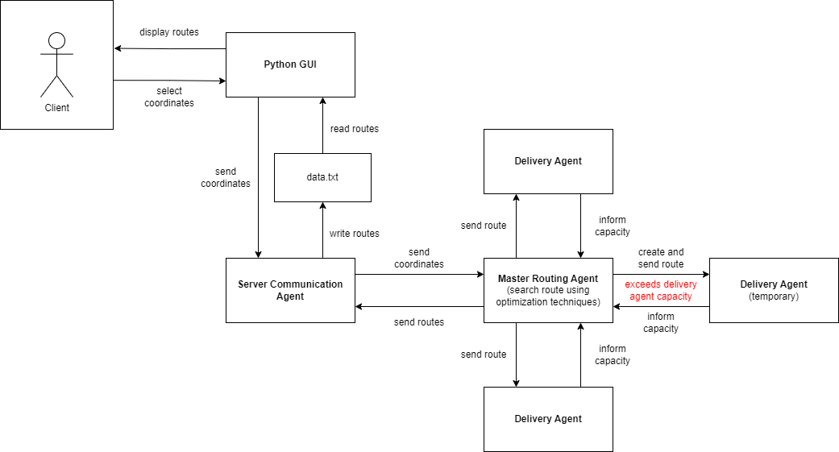
System Architecture

Slide 5
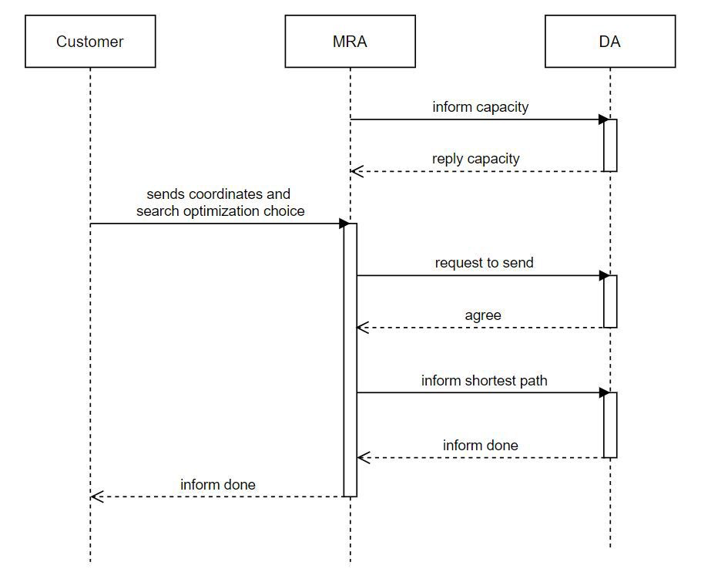
Communication Protocol

Slide 6
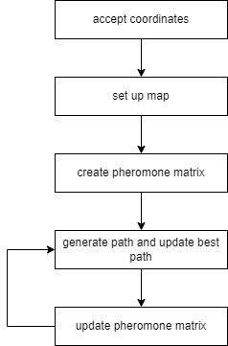
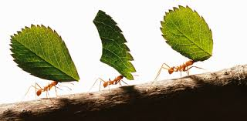
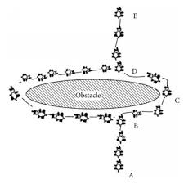
Optimization Technique
Ant Colony Optimization
Inspired by the foraging behavior of ants
Uses artificial 'ants' to explore possible routes and find optimal solutions

Slide 7
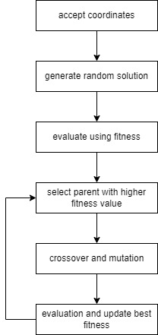
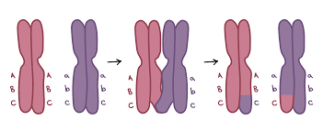
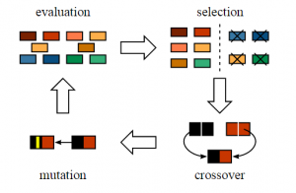
Optimization Technique
Genetic Algorithm
Based on the principles of natural selection and genetics
Uses concepts of mutation, crossover, and selection to evolve solutions over generations

Slide 8
The End

